Slide 1
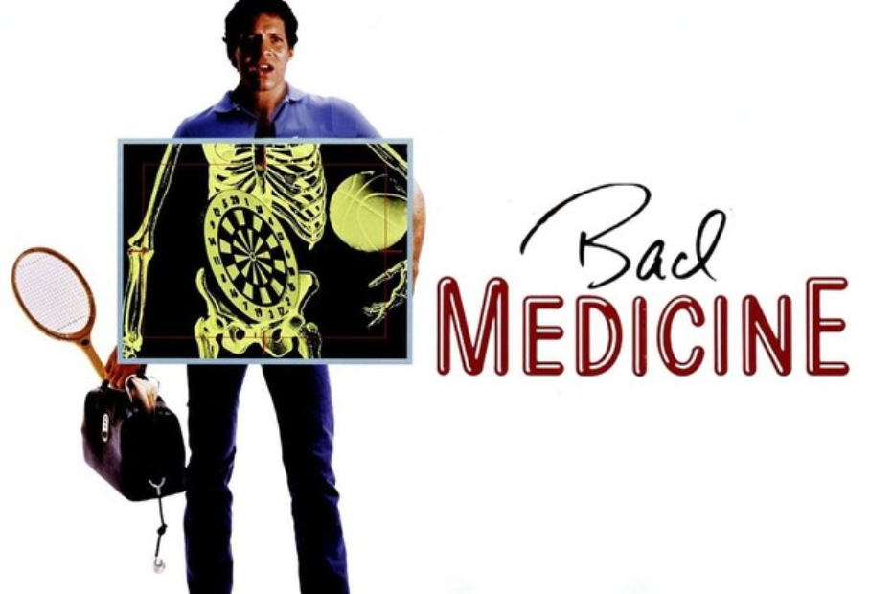
Eric Prebys
FRS-003-009

Slide 2
Don’t Believe Everything You Hear!
As we’ll see, a lot of the problems with medical misinformation are due to bad reporting, both by the media and public figures.
For medicine or anything else, always try drill down to the original source
It often bears little relation to what’s reported!
This includes the things I say!
I try to provide links to the original source for anything significant
Your Davis credentials will give you access to most journals
Some of the newspaper articles are behind paywalls, but you can usually get a couple of free articles, and they’re summarized elsewhere.
Pro tip: ChatGPT is really good at explaining technical jargon – including medical jargon – into plain English.
Just cut and paste the abstract into ChatGPT and ask what it means.

Slide 3
Start with Good Medicine: The “Big Win”
The average human life-span in the developed world more than doubled in the 20th Century
From about 35 to about 78
This was NOT because maximum human life-spans have increased
There are records in ancient Rome of people living to be over 100.
Just not very many.
The average life-span has increased because we’ve eliminated many causes of death at younger ages, particularly
Deaths from childhood diseases
Deaths in childbirth for both mothers and children.
In 1900, 16.5% of children in the US died before their first birthday.
Now it’s 0.53% - a factor of 30 lower!
The biggest factors were:
Improved sanitation and clean water
Antibiotics
Vaccinations
Improved maternal and infant care
All of these involved understanding the role of germs
So where did that come from?…

Slide 4
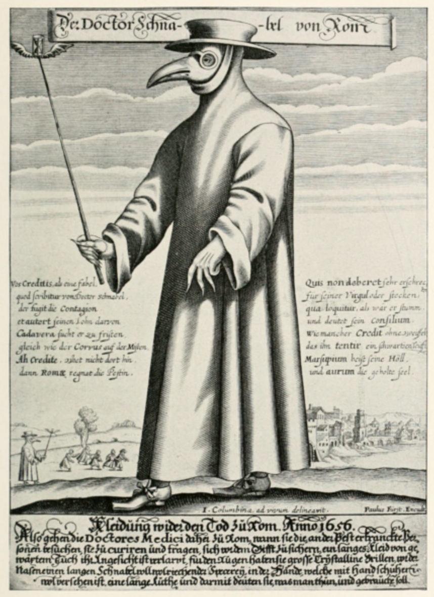
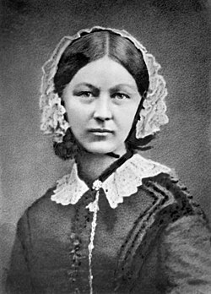
Miasma Theory
In the 5th Century BC, Hippocrates suggested that diseases are caused by “bad air”, produced by rotting organic matter.
“miasma” is a Greek word meaning something like “pollution”
“Malaria” literally means “bad air”
This theory dominated medicine until the late 19th Century!
It was believed bad air would smell bad.
This gave rise to “plague masks”, which were filled with flowers and and other aromatics (and did absolutely nothing).
It also prompted people to clean up their garbage, which accidentally quite a bit of good. For example, Florence Nightingale believed miasma theory and that caused to champion cleanliness.
How did we get to germ theory?

Slide 5
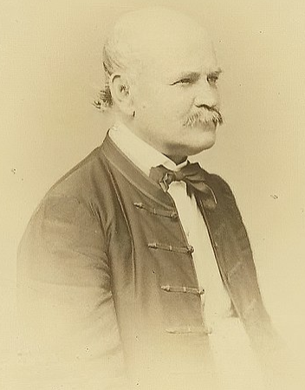
Doctors vs. Midwives
In 1846, while working in Vienna, Dr. Ignaz Semmelweis, observed that (rich) women, who had their babies delivered by doctors were almost three times more likely to die, usually from puerperal fever, than (poor) women who had their babies delivered by midwives.
The difference?
Doctors considered it a badge of honor to have a bloody smock and would often go straight from dissecting a cadaver to delivering a baby without washing their hands.
Midwives washed their hands because delivering babies is, well, kind of gross.
He blamed it on "cadaverous particles" from the corpses and recommended that everyone wash their hands with chlorine
Because he liked the smell (he still believed in miasma theory)
Maternal deaths fell dramatically
Infections went from 18% to 2% !
Semmelweis tried to convince the world of his revelation, but was largely rebuffed.
The stress caused by this was too much, and he was eventually committed to a mental institution.
Where he ironically died of sepsis after being beaten.

Slide 6
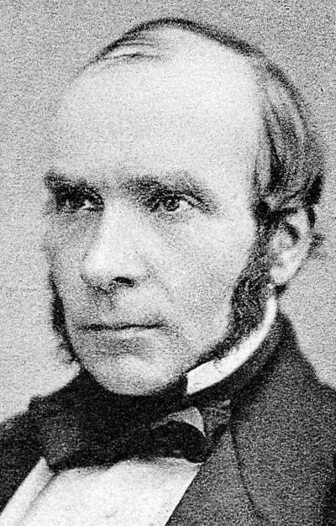
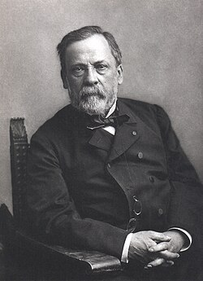
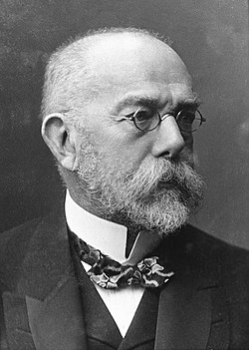
Building the Case for Germ Theory
John Snow
In studying the 1854 Broadstreet Cholera Outbreak in the UK, Snow proposed a fecal-oral transmission, transported by water
Hypothesizing that the infectious agent was biological in origin, he proposed boiling and filtering water, which saved many lives.
Louis Pasteur
Pasteur showed that treating the female genital tract with boric acid reduced postpartum infections, indicating the infections were biological in nature.
He disproved “spontaneous generation” and showed these “germs” must travel from one place to another for infection to spread.
Robert Koch
Established “Koch’s Postulates” for associating a particular bacteria with a particular disease or infection:
The microorganism must be found in abundance in all organisms with the disease, but should not be found in healthy organisms.
The microorganism must be isolated from a diseased organism and grown in pure culture.
The cultured microorganism should cause disease when introduced into a healthy organism.
The microorganism must be re-isolated from the inoculated, diseased experimental host and identified as being identical to the original specific causative agent.
There were lots of others, but these were (IMHO) the big players

Slide 7
Effects of Germ Theory
The immediate effect of germ theory was a dramatic reduction in infections of all types by introducing carbolic acid and other disinfectants
Had this existed a few years earlier, it would have saved most of the lives lost in the Civil War, who died of infection rather than their injuries.
A drive to improve sanitation and clean up water supplies
This has had the biggest single effect on reducing mortality
By identifying a causal mechanism, improved research and understanding of diseases.
Led to development of antibiotics, which have saved countless lives.
Facilitated the development of vaccines

Slide 8
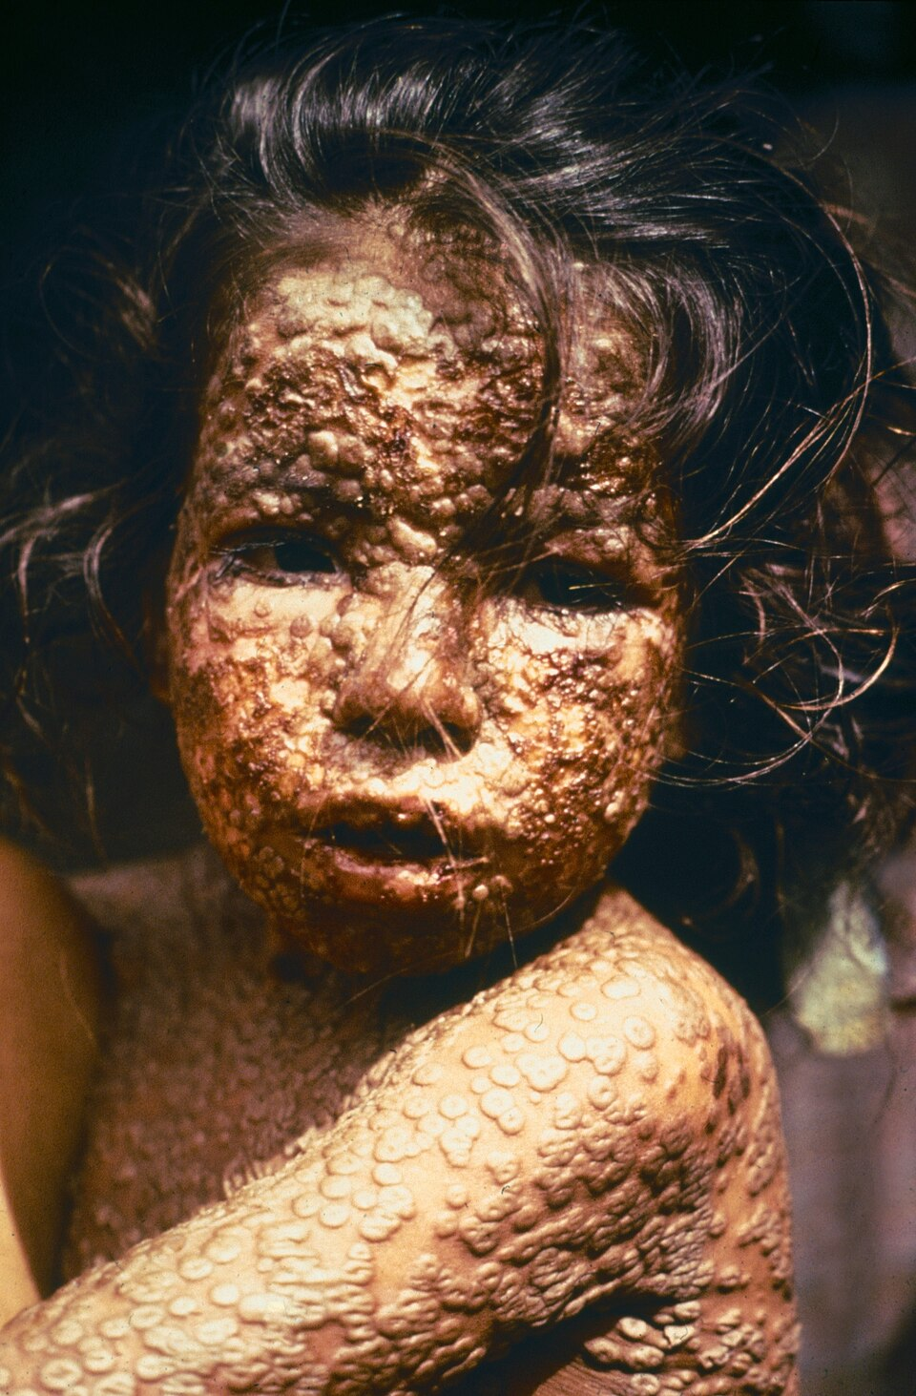
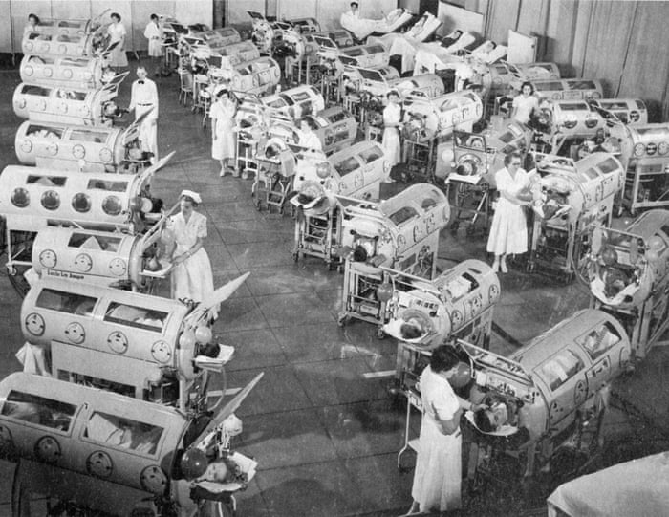
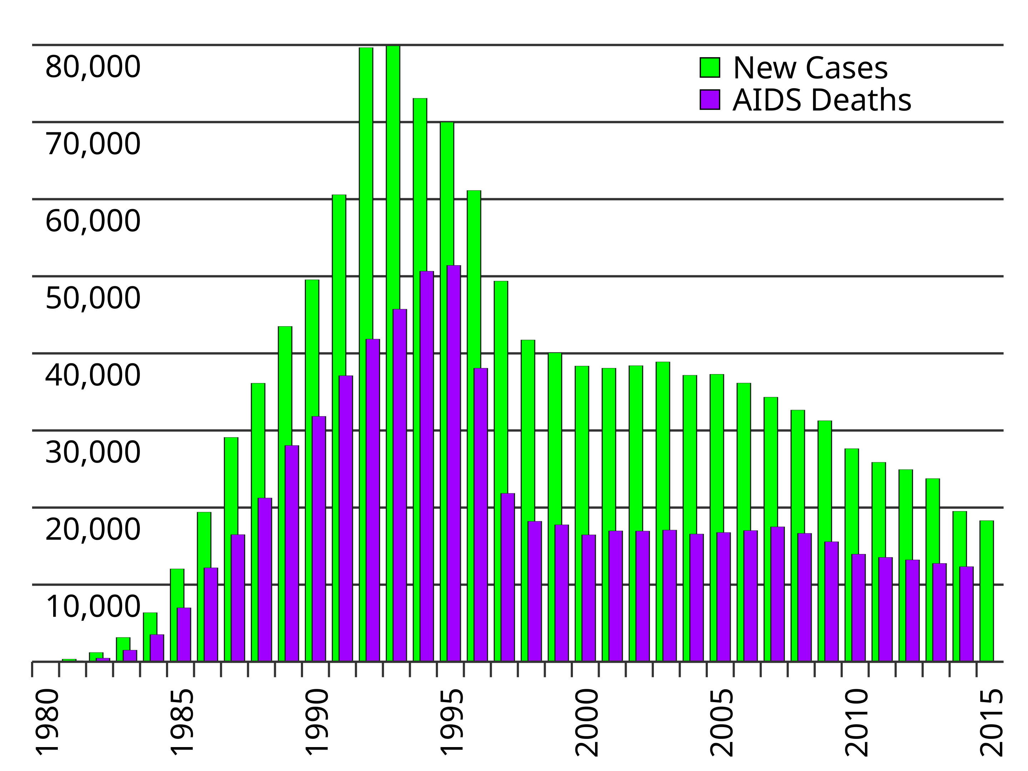
Some Huge Successes
Smallpox
Killed between 200M and 500M people in the 20th Century
First vaccine developed in the 1950s
Declared totally irradicated on May 8th 1980
Polio
Polio killed or paralyzed half a million people annually in the 1940s and 1950s
First polio vaccine developed in 1955
Nearly eradicated
HIV/AIDS
When the AIDs epidemic broke out in the 1980s, it was a death sentence
While there is no cure, improved treatment greatly improves the outlook, at least in the First World
So it might surprise you to learn that some people don’t believe in germ theory

Slide 9
Robert F. Kennedy Jr. Doesn’t Believe in Germ Theory
His book, “The Real Anthony Fauci” (2021) has a chapter entitled “Miasma vs. Germ Theory”
On Miasma Theory:
“’Miasma theory’ emphasizes preventing disease by fortifying the immune system through nutrition and by reducing exposures to environmental toxins and stresses. Miasma exponents posit that disease occurs where a weakened immune system provides germs an enfeebled target to exploit.*”
On germ theory:
“Germ theory aficionados, in contrast, blame disease on microscopic pathogens. Their approach to health is to identify the culpable germ and tailor a poison to kill it. Miasmists complain that those patented poisons may themselves further weaken the immune system, or simply open the damaged terrain to a competitive germ or cause chronic disease.”
But back to the real world and modern medicine, and its problems…
Huh?
*If you’ve been paying attention, you’ll notice this isn’t even close to miasma theory. He’s actually talking about “terrain theory”, which is totally different.

Slide 10
Begley’s Bombshell*
In the early 2000s, C. Glenn Begley left academia to work in a lab at the biotech company Amgen, looking for new treatments for cancer.
He had his staff scour the literature for results that looked promising.
The problem is, he found that he could almost never reproduce the results in his own lab.
They reached out to the original authors and asked them to assist them in reproducing the results, using the original methodology, but (where appropriate) under stricter blinding conditions imposed by Begley. Most agreed.
Out of 53 results only six could be reproduced (11%).
Begley joined with Dr.Lee Ellis at MD Anderson to publish these results in Nature in 2012, under the title
”Raise standards for preclinical cancer research”
Not surprisingly, this paper did not make them popular.
*The next few slides are mostly based on Rigor Mortis

Slide 11
Unavoidable Problems With Medical Research
People are complicated!
No two people are exactly alike
Even identical twins
It’s very hard to control for confounding factors:
Genetics
Socio-economic conditions
Other health issues
Very hard to ethically do the kind of controlled studies we’d like to do
Can address this somewhat with animal testing, but results may not be the same.

Slide 12
Problems with Medical Research Culture
Emphasis on quantity over quality in publications
Low threshold to claim an effect
p value of .05 is considered the threshold (= 2σ = drawing 2 pair)
Traditionally rampant p-hacking (getting better)
Blinding procedures not universally applied.
Acknowledged bias against publishing null results
Great potential for conflicts of interests
LOTS of money in medicine
The temptation to “fudge” results is great, even it it’s not intentional.
From Rigor Mortis:
“Scientists often face a stark choice: they can do what’s best for medical advancement by adhering to the rigorous standards of science, or they can do what they perceive is necessary to maintain a career in the hypercompetitive environment of academic research. It’s a choice nobody should have to make.”

Slide 13
Review: p-value and p-hacking
Medical results usually quote the “p-value”, which is generally used in two ways:
The probability that an observed result can be explained as a statistical fluctuation of the null hypothesis.
The probability that the true value of a measurement is outside of a particular range.
For example: “The increased risk factor is 1.2-2.1 (p-value=.05)”
Focusing on the first definition, the accepted standard to claim “evidence” is a p-value = .05.
That’s the probability of 2-pair on the first deal
If I do enough measurements, I’m all but guaranteed to see at least one result with p<=.05 through statistical fluctuations alone.
In our little card experiment, out of 20 “measurements”, we got
3 of a kind (p-value = .02)
A straight (p-value=.003)
This is known as ”p-hacking”.
The effect of p-hacking is mathematically trivial, but it wasn’t widely acknowledged until a paper in 2011
“False-Positive Psychology: Undisclosed Flexibility in Data Collection and Analysis Allows Presenting Anything as Significant”
Since then, steps have been taken to reduce, but not eliminate, the problem.

Slide 14
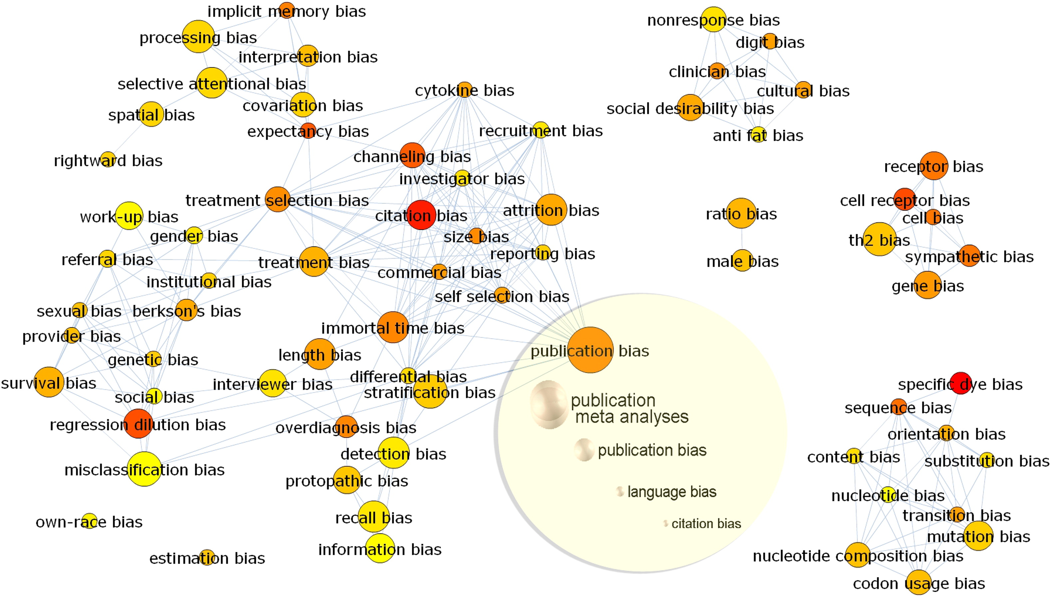
Biases in Results
Because of the complexity of medical research, there are many ways that results can be biased
A 2010 paper identified 235 individual bias terms that had at least been addressed in the literature.

Slide 15
Some Important Biases
Observer Bias
In some cases, results involve some degree of judgement.
For example, “did the patient improve”?
Selection Bias
You may come up with perfectly defensible reasons to reject data that doesn’t support your hypothesis.
Sample Bias
Example: for a long time, researchers preferred to use male mice to avoid dealing with the estrus cycle of female mice.
The problem here should be obvious.
Lots of examples in which using primarily white subjects biases against issues finding issues that might be race dependent.
Publication Bias
There has been a longstanding problem of researchers who are reluctant to publish null results.
This is a particular problem for meta-analyses, because it may imply a confirmation that just isn’t there.
Blinding can go a long way toward reducing such biases

Slide 16
Publication Bias
A seminal paper in 1986 concluded that published cancer therapies were strongly biased toward positive results, and that in many cases, the observed effect went away entirely when compared to a larger sample ascertained by studying the medical registry
In 2015, a study investigated researchers who had received NIH funding for the treatment of depression from 1972 to 2008.
Of 55 groups, 13 had not published their results because they were negative.
A similar study in 2014 found that positive results in clinical trials were roughly twice as likely to get published as negative ones.

Slide 17
Blinding Example: A double-blind Drug Trial
Some patients are given a drug.
Some are given a placebo.
Objective criteria are established beforehand to evaluate the success of the drug.
During the test, neither the patients nor the person evaluating the success know which ones got the drug and which ones got the placebo.
Unblind only after all the tests have been completed.
Publish the results, whatever they show.
Still can be problems.
For example, what if the drug has an obvious side effect, like fever or nausea?

Slide 18
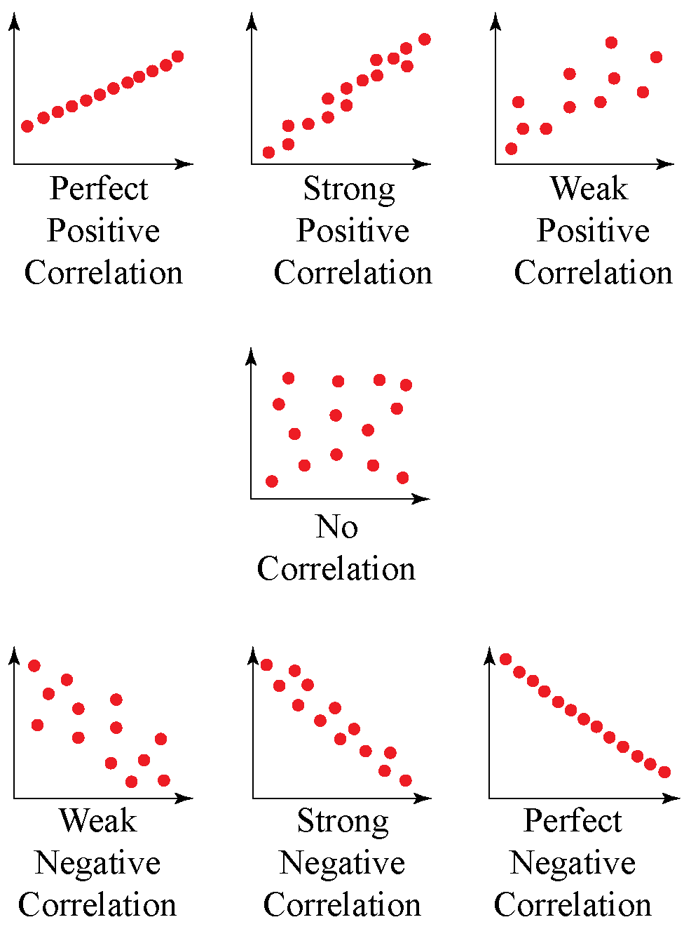
Review: Correlation
Two things are said to be “correlated” if they tend to vary together.
If I make two measurements or observations simultaneously and scatterplot them, I can observe whether they are correlated or not.
Examples:
Perfect correlation: temperature in F and temperature in C.
Positive correlation: one’s income and cost of their house
Negative correlation: Price of gasoline and number of road trips.
Many medical studies look for correlation as evidence of causation
But correlation alone does not prove causation

Slide 19
Confounding Factors
If two things are both correlated to a third thing, they will be correlated to each other, regardless of any causal link.
Examples:
Heart disease has a significant correlation to coffee drinking.
Confounding factor: both are independently correlated to smoking.
Some studies have shown wine drinkers have a longer life expectancy than beer drinkers
Confounding factor: both a tendency to drink wine and access to better healthcare correlate strongly with wealth.
Simple confounding factors can be corrected for
For example, I could restrict my coffee study to people who don’t smoke.
Individual observations may have multiple confounding factors, some of them very subtle.

Slide 20
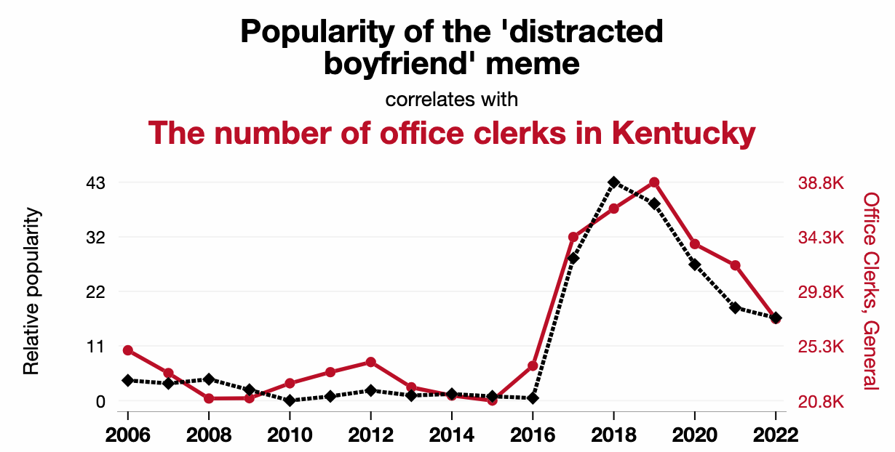
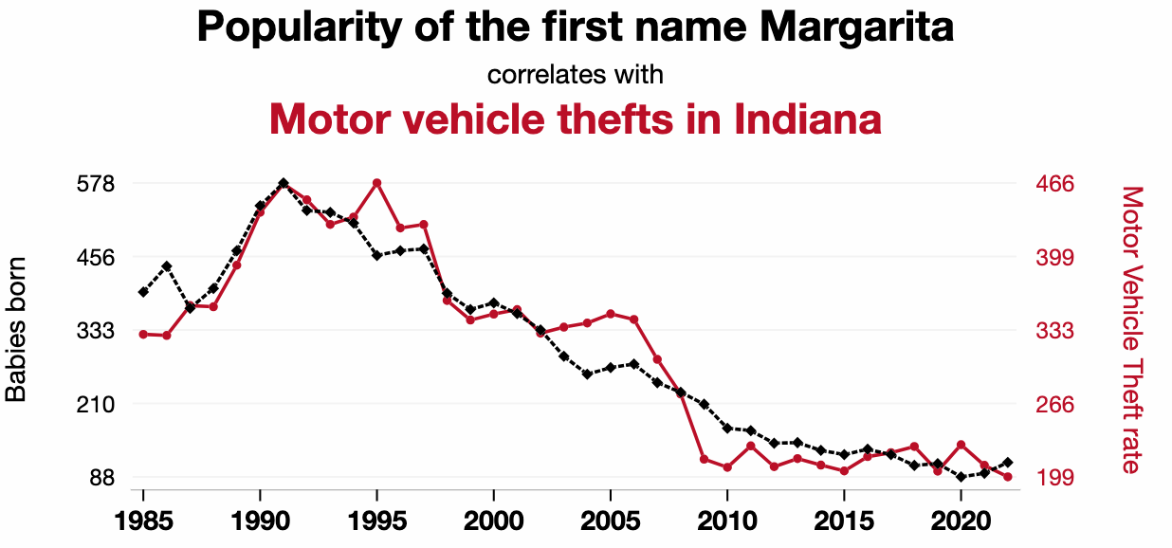
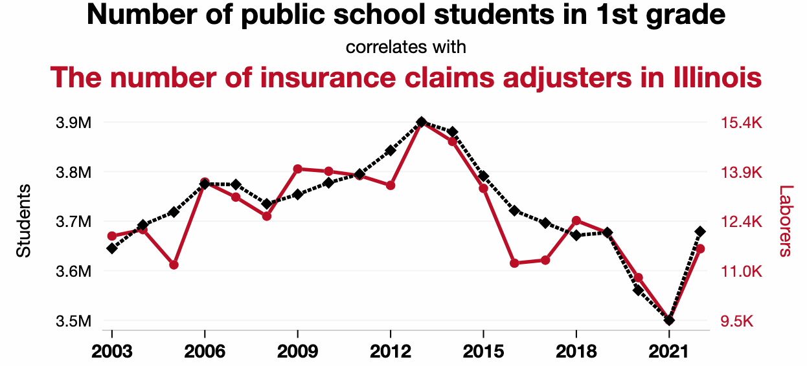
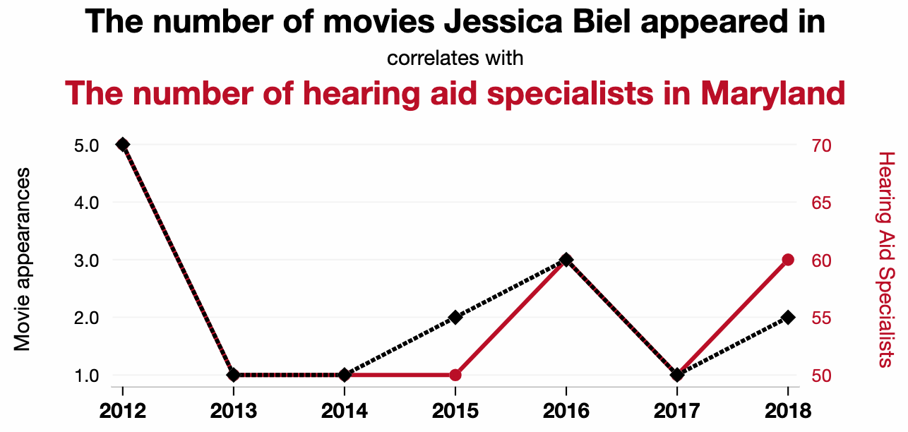
Anomalous Correlation
If I look for enough correlations, I’m going to find some just through statistical fluctuation
This is just another type of p-hacking
This fun site combs through thousands of databases looking for clearly nonsense correlations*
*credit Matthew Domeier at Fermlab for finding this.

Slide 21
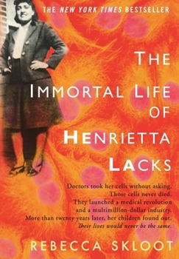
Compromised Cultures
In laboratory studies of many therapies, researchers rely on genetically identical cells.
For example, “HeLa” cervical cancer cell line was originally cultured from Henrietta Lacks*, who died in 1951. It’s still around and widely used.
Unfortunately, many of the companies supplying these cells don’t have the highest standards and upon inspection, many cultures are not what they think
In fact, many turn out to be HeLa!
A paper published in 2008 concluded that between 18% and 36% of published cancer studies were based on contaminated or completely misidentified cell lines!
*without the knowledge or approval of her or her family

Slide 22
Where is Medicine Today?
For everything I’ve talked about, the situation has improved in recent years, but problems still persist.
Never believe a single published result, or even numerous results if the significance does not improve.
Always remember Bob Park’s third warning sign.
Remember that most doctors are not researchers!
Their experience with their own patients is not a substitute for scientific studies.
They are just as capable of believing crazy things as non-medical people.
Still, there are much worse things…

Slide 23
“Alternative Medicine”
Axiomatic (to me) statement:
If something genuinely produces an effect (good or bad), it can be scientifically proven to produce that effect to a high degree of confidence.
Something that has been proven to have a beneficial effect on health is referred is referred to as “medicine”, whatever its origin or nature.
The ”alternative” is somethings that either:
Has not been proven to have a beneficial effect.
Has been proven NOT to have the claimed beneficial effect.
”Alternative Medicine” isn’t really a thing, but I’ll stipulate the use of the term for some things that are difficult to test.

Slide 24
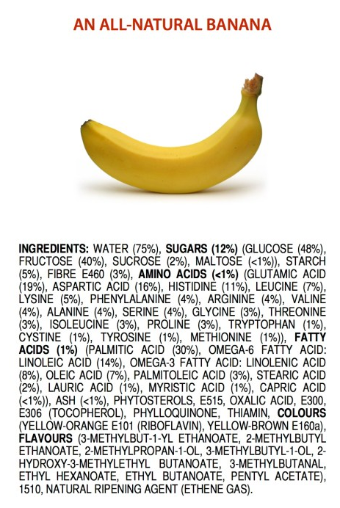
A Couple of Comments
Everything is made of chemicals!
The only way to not consume chemicals is to stop eating, drinking, and breathing
“Natural” does not mean “safe”. Here are just a few examples of unsafe natural things:
Lead
Mercury
Asbestos
Radon
Nightshade
Hemlock
Arsenic
Numerous mushrooms
That plant that killed the “Into the Wild” guy
etc, etc
Many “natural remedies” have adverse side effects.

Slide 25
The Use of “Natural Remedies”
Many common drugs have their origin in traditional natural remedies.
Aspirin is based on a remedy made from the bark of a willow tree that has been around for over 2000 years.
Quinine was also extracted from tree-bark and became an early anti-malarial drug
And also gave birth to the “gin and tonic”
Modern opioids are based on natural opiates like morphine, which are extracted from poppy plants.
A huge number of drugs are based on naturally occurring alkaloids, including all the ”-caine” anesthetics, antihistamines, anti-cancer drugs, etc.
The biggest problem with testing natural remedies is money.
A full clinical trial of a drug costs 10s to 100s of millions of dollars.
Drug companies are not going to pay that kind of money for something they can’t patent!
Have to rely on academic studies, mostly supported by the government.
Even the best academic study is not as good a clinical trial

Slide 26
Stages to Approve a Drug
Pre-clinical:
Demonstrate efficacy of the drug in in-vitro or animal tests.
Establish a dosage recommendation
Phase I (Safety and Dosage):
20-100 volunteers, usually without the condition (except cancer)
Identify safe dosage range and look for side effects
Do not evaluate effectiveness yet!
Phase II (Efficacy and Side Effects):
Several hundred patients with the target condition.
Use randomized, controlled trials, compare the drug to a placebo to determine its efficacy.
Continue to assess safety and optimal dose
Phase III (Confirmatory Trials):
1,000-3,000 patients in multiple locations
Use randomized, double-blind trials to confirm effectiveness and safety and use these to establish a risk-benefit ratio
If favorable, submit a New Drug Application
Getting through Phase I-III takes between 2 and 6 years and costs tens to hundreds of millions of dollars.
Regulator Approval
The appropriate agency evaluates the drug for safety and effectiveness
If the drug is approved, it can be marketed and prescribed.
Phase IV (Post-Marketing Surveillance)
Continue to monitor the drug for rare of long-term side effects
Can result in restriction or removal of drug.
5-10%
60%
30%
60%
~10%

Slide 27
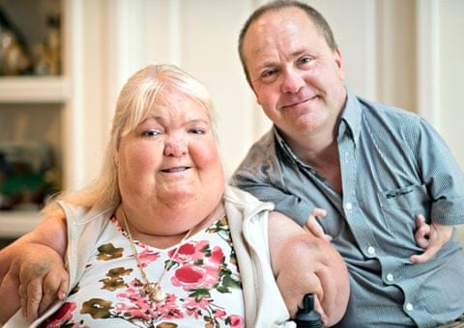
Some BIG Mistakes
In spite of all of this, some very dangerous drugs have gotten through.
Thalidomide:
Developed in the 1950s as a drug for anxiety, sleeping difficulties, and morning sickness.
Never tested properly on pregnant women!
Found to have horrific effects on fetuses, resulting in
~10,000 profound birth defects, usually shrunken or missing limbs.
~2,000 deaths
Resulted in much better controlled trials
Vioxx (Rofecoxib)*:
Develop by Merck for the treatment headaches and other pain.
Approved for sale in 1999
Found to be associated with dramatically increased risk of heart disease and death
Around 100,000 cases of severe heart disease in the US alone.
Withdrawn from the market in 2004
Later, it was revealed that some of the safety studies had been fabricated.
This has contributed to the distrust of the pharmaceutical industry.
*see Behind the Bastards: The Vioxx Scandal: How Big Pharma killed more Americans than Vietnam.

Slide 28
Dietary Supplements
What’s the difference between a “drug” and a “supplement”
A drug is intended to diagnose, cure, mitigate, treat, or prevent disease.
Regulated in the US by the FDA’s Center for Drug Evaluation and Research (CDER).
Must go through rigorous premarket testing (clinical trials) to prove safety, efficacy, and quality.
A supplement is intended to add to or support the diet, not to treat or prevent diseases*.
Regulated under the Dietary Supplement Health and Education Act (DSHEA) of 1994.
Do not require FDA approval before marketing.
The manufacturer is responsible for ensuring safety and proper labeling.
FDA can only act after a product is found unsafe or mislabeled.
Dietary supplements are roughly a $150B business in the US.
*although “natural remedies” are primarily classed as dietary supplements.

Slide 29
The Dietary Supplement Health and Education Act (DSHEA)
Originally, dietary supplements were completely unregulated.
Congress was considering bills to put dietary supplements under the control of the FDA.
In response, the supplement industry started a well-funded lobbying campaign.
Including entertaining TV ads like this.
The compromise was the DSHEA
All existing supplements grandfathered in.
Requires that companies notify the FDA of new supplements and provide “reasonable evidence” of their safety; however, the FDA has no authority to block the sale of a supplement at this point.
They are not required to submit any evidence of the supplement’s claimed effectiveness!
The FDA only gets involved after the fact if there’s evidence that a supplement is harmful.

Slide 30
Some Supplements that Have Been Studied
A few that probably work:
Vitamins are good for you, but only to offset vitamin deficiencies
Vitamins don’t treat diseases, and overdosing can be bad for you.
St. John’s Wort, for treating depression
Creatine monohydrate, for increasing muscle mass
Omega-3 fatty acids (fish oil), for heart health
Melatonin, for jet lag (evidence not overwhelming)
A few that probably don’t
The use of any of the above for other things
e.g creatine monohydrate for Parkinson’s etc.
Glucosamine for joint pain
Ginko Biloba for improved memory or the treatment of dementia
There is no fundamental difference between the way a natural remedy works and the way a synthetic drug works.
There are always dangers of side effects and interactions with other drugs, natural or otherwise!

Slide 31
Some Supplements that can be Dangerous
Ephedra (ma huang): Once common in weight-loss pills; banned by the FDA in 2004 after causing heart attacks, strokes, and over 155 deaths.
Colloidal Silver: No health benefits, and can be very dangerous
Bitter orange (synephrine): Sometimes used as an “ephedra substitute,” but can also raise blood pressure and heart rate.
Kava: Marketed for anxiety; associated with severe liver toxicity in rare cases.
Comfrey: Contains pyrrolizidine alkaloids that can cause liver failure; unsafe for oral use.
Yohimbe: Used for sexual enhancement or bodybuilding; can cause high blood pressure, anxiety, and heart arrhythmias.
Aconite (“wolf’s bane” or “fuzi”): Found in some traditional Chinese preparations; highly toxic and can cause fatal arrhythmias.

Slide 32
No Medicine is Better than Bad Medicine
Some background:
People learned how to do amputations, set broken bones, and do sutures a LONG time ago.
Before the late 19th Century, a lot of other things doctors did were actually quite bad for you.
Bleeding!
Arsenic
Mercury salts (particularly for syphilis)
Tabacco smoke enemas (no, I’m not making that up)
On the other hand:
The human immune system is truly amazing.
Most of the time, when you get sick, you get well again all on your own.
People don’t like to do nothing, so taking something that does nothing was sometimes a better option than the treatments at the time.
Which brings us to…

Slide 33
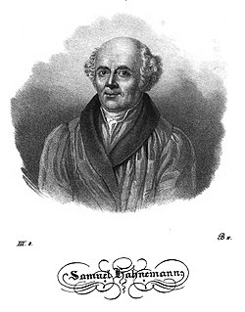
Homeopathy
Note: most people have no idea what homeopathy is, and it’s often misused as a synonym for “natural”, but it has a definite meaning.
It was developed in 1796 by the German physician Samuel Hahnemann, based on the theory that “like cures like”:
Identify something that causes a particular symptom (pain, sneezing, etc)
Add a small quantity of that to water
Dilute the water by successively adding a small quantity of it to a larger quantity, shaking it (referred to as “succussion*”), and repeating many times.
The resulting diluted mixture will cure the symptom in a person.
*”traditionally 10 firm downward strokes of the arm, on a book” (video)

Slide 34
The Problem?
Homeopathic dilutions:
Dilutions are described by a number of dilution cycles, followed by a code representing the dilution factor for each cycle:
X (or D) for a factor of 10 dilution at each step
C for a factor of 100 at each step.
It’s believed that the more you dilute it, the stronger it gets.
If you start with a liter, then a 30X dilution will be diluted factor of 10⁻³⁰, at which point there won’t be a single molecule of the original substance left.
Homeopathic remedies typically start at 30X and go as high as 100C = 10⁻²⁰⁰, at which point, there wouldn’t be a single molecule left if you started with all of the oceans on Earth.
In other words, homeopathic ”medicine” is nothing but pharmaceutically pure water!

Slide 35
How Did Homeopathy Catch On?
As I was saying, doing nothing was often better than the ”medical” alternative at the time.
For example, from this source (emphasis mine):
During the 19th-century cholera epidemic, death rates at the London Homeopathic Hospital were three times lower than at the Middlesex Hospital. Homeopathic sugar pills won't do anything against cholera, of course, but the reason for homeopathy's success in this epidemic is even more interesting than the placebo effect: at the time, nobody could treat cholera. So, while hideous medical treatments such as blood-letting were actively harmful, the homeopaths' treatments at least did nothing either way.
But is there any evidence that homeopathy actually does anything.

Slide 36
Does Homeopathy Work?*
Over the years, a number of studies have purported to show statistically significant effects from homeopathic treatments.
However, later meta-analyses concluded these were the result of a combination of p-hacking and publication bias.
Later, better controlled studies have consistently found that the effects of homeopathic treatments are consistent with placebos (see, eg, this paper)
In 1988, a group led by Jaques Benveniste published a paper in Nature, titled
“Human basophil degranulation triggered by very dilute antiserum against IgE”
which purported to show evidence that water could have “memory”, even when diluted beyond Avogadro’s Number. It caused quite a stir.
Two weeks later, Nature sent an investigation team to Benveniste’s lab, which included James Randi, a professional magician and debunker.
Randi devised a “fool proof” double-blind protocol, with the full cooperation of Benveniste
Under this protocol, they could not reproduce the results.
Although it was never proven, Randi believe an over-zealous lab tech had falsified the previous results.
I heard Randi talk about this at the same 1989 APS meeting where they debunked Cold Fusion!
*No

Slide 37
Some Other Quack Therapies
Useless but harmless*
Gong baths
Reiki (massaging without touching)
Color therapy
Crystal healing
Magnetic and copper bracelets
Faith healing
Useless and dangerous
Coffee enemas and other extreme “detox” measures
Gerson therapy and other diet-based “cancer treatments”
Colloidal silver
Hydrogen peroxide therapy
Chlorine.
*nothing is harmless if if makes you forego real medicine.

Slide 38
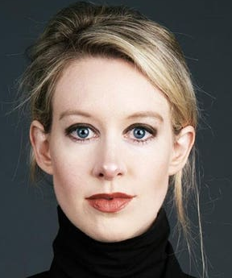
And Sometimes it’s just Fraud
In 2003, 19-year-old Elizabeth Holmes founded Theranos and claimed to have developed a technology that could perform hundreds of medical tests with a single drop of blood.
Using a machine called the Edison
The media totally ate it up:
Young female Stanford dropout sets medical world on its ear!
(put a pin in this for our Science and the Media lecture)
She was great at getting investors!
Raised $700M from venture capitalists
In 2012, signed a $350M contract with Safeway to install machines in 800 locations.
In 2013, signed a partnership with Walgreens to install machines in 40 locations
Numerous partnerships with clinics
At its peak Theranos was valued at $9B
Her net worth was estimated at $4.5B
So why don’t we have these machines at your local Walgreens or Safeway?

Slide 39
The End of Theranos
There were HUGE red flags right from the beginning
Remember what I said in the first lecture about “science” vs. “technology”
There have been many famous college dropouts who have founded tech companies (Bill Gates, Steve Jobs*, Mark Zuckerberg, etc), this required hundreds of scientific breakthroughs, and a college sophomore simply doesn’t have the skills.
Most of the investors were had never invested in biotech before. Traditional biotech VCs avoided Theranos like the plague.
In 2015, Stanford Professor John Ioannidis published a letter in the JAMA pointing out that Theranos had published NO peer-reviewed articles on any of the procedures that had allegedly been developed
Exposure and Downfall
Later in 2015, John Carryrou published an article in the WSJ revealing that the Edison machines were just props. Theranos had in fact been shipping blood samples back to their lab and using off the shelf Siemens machines, which required them to highly dilute the blood samples, making them extremely unreliable.
By 2018, the valuation of Theranos and Holmes’ net worth had fallen from billions to almost zero and the company shut down
That year, she and her partner Sunny Balwani were indicted with multiple counts of fraud.
They were both found guilty on several counts, and in 2022 were sentenced to 11 and 12 years in prison, respectively, where they both now reside.
*Holmes was so obsessed with Jobs that she started to dress and talk like him.

Slide 40
A (Very) Brief History of Autism
Historical descriptions of certain people show that autism has always been around.
Autism was first identified in 1911 by Eugen Bleuler, as a type of schizophrenia.
It was identified in1943 by Leo Kanner as a formal diagnosis but still considered a type of schizophrenia.
It wasn’t until the 1970s that it was acknowledged to be a completely separate diagnosis.
In the 1930s, Hans Asperger and Leo Kanner identified a separate syndromes that came to be called “Asperger’s Syndrome” and “Infantile Autism”
Asperger’s became a formal diagnosis in the 1990s.
In 2013, Asperger’s Syndrome, Infantile Autism, and Autism were all formally combined into “Autism Spectrum Disorder” (ASD)
Asberger’s is now considered “very high functioning autism”.

Slide 41
Some Characteristics of Autism
ASD ranges from “socially awkward” to completely non-communicative.
Deficits in social and communication skills
Social-emotional reciprocity
Empathy
Contact
Non-verbal communication
e.g. reading “body language”
Repetitive behavior
“stimming”
Counting or arranging objects
etc.
Emotional Fragility
Tantrums or melt-down, particularly if overstimulated.
(occasionally) Exceptional talents (”savant” behavior)
Musical skill
Math skill
etc

Slide 42
Causes of Autism
Early attempts at explaining autism blamed it entirely on the mothers
In 1949, Kanner wrote a paper that blamed autism on “lack of maternal warmth”.
His statement the the children were metaphorically “left neatly in refrigerators which did not defrost” gave rise to the term “refrigerator mother”
This remained the accepted explanation until the late 1970s!
The undisputed increase in the diagnosis of autism (60-fold in 30 years) has convinced people there must be a cause
Much of this increase is due to more careful screening and expanded definitions (including Asperger’s alone cause the biggest increase)
Whether this alone is responsible remains a matter of debate, and is beyond my expertise to comment on.
After years of study, the ONLY undisputed cause is genetics
heritability estimates ranging from 60–90%
People continue to search for other causes.

Slide 43
Vaccines and Autism
In 1998, a group led by Andrew Wakefield published a paper the prestigious medical journal The Lancet, entitled
“Ileal-lymphoid-nodular hyperplasia, non-specific colitis, and pervasive developmental disorder in children:
It purported to show a link between the MMR vaccine and both multiple gastrointestinal disorders and “pervasive developmental disorder” (PDD), including autism.
The world went nuts!
And continues to be nuts.
It should be pointed out that this was already a very questionable study
It involves a sample size of 12(!), ALL of whom reportedly had been diagnosed with PDD.
The reported time between the MMR vaccines and an PDD diagnosis was suspiciously short (2 weeks to 2 months)
The “control” group was only relevant to the autism/gastrointestinal link, NOT the vaccine link.
How the hell did this get published in one of the premier medical journals?

Slide 44
Effect of the Paper
The claims of the paper were rather weak, and in fact said a causal link had not been proven.
Multiple subsequent studies with higher statistics found NO link:
See, eg, http://news.bbc.co.uk/2/hi/health/1808956.stm
Nevertheless, in public
Wakefield strongly pushed a causal link between MMR vaccine and autism
He suggested without evidence that it was the combination of the three vaccines that was causing problems.
He became the darling of the growing anti-vax movement.
As a result*
Over the next several years, vaccination rates in the UK fell from 92% to 80%
The number of measles cases grew from 56 in 1998 to 1,348 in 2008, of which 2 died.
*Sunday Times, February 8, 2009

Slide 45
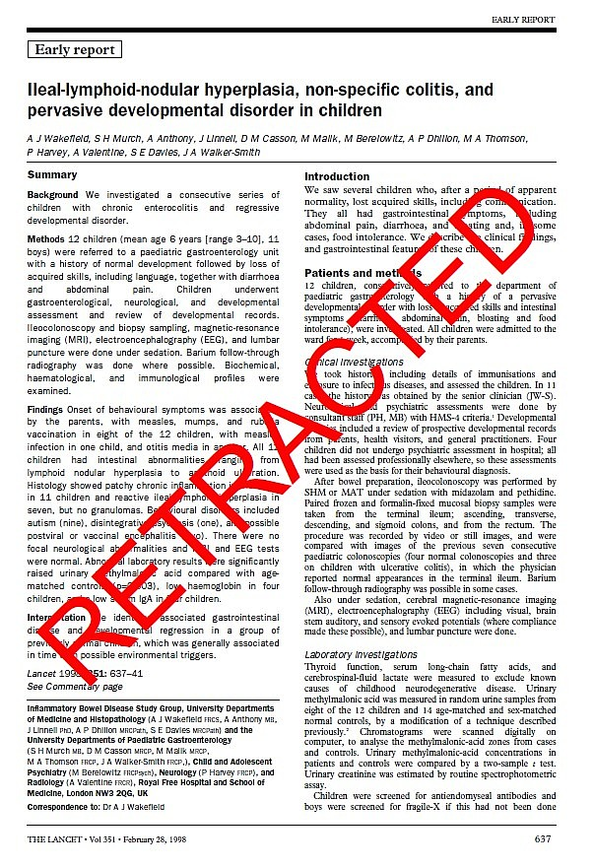
Big Problems for Wakefield…
In 2004*, an investigation by the Sunday Times found that Wakefield had failed to disclose:
He was paid £50,000 by Legal Aid on behalf of lawyers representing parents suing vaccine companies over an MMR/autism link
He funneled those children into the study
Further investigation** by the Times found that he was paid an additional £435,000 directly from the lawyers.
In 2009, Further further investigation found that in addition the failure to disclose his conflict of interest, he had manipulated the data significantly***:
”In most of the 12 cases, the children's ailments as described in The Lancet were different from their hospital and GP records”
“in many of the cases medical concerns had been raised before the children were vaccinated”
As a result, the paper was retracted in 2010
And that was the end of it, right?
*Sunday Times, February 22, 2004
**Sunday Times, December 31, 2006
***Sunday Times, February 8, 2009

Slide 46
You Know it Wasn’t…
In spite of the scandal, MANY people still cite Wakefield’s original paper as proof of a link between vaccinations and autism.
Robert F. Kennedy Jr, the current US Secretary of Health and Human Services, remains a passionate defender of Wakefield.
The unapologetic Wakefield remains very active in the antivax movement.
People continued and continue to believe that vaccines cause autism, in spite many high quality, high statistics studies showing they don’t.
See the Wikipedia article and supporting links.
Many people focused with no evidence whatsoever on the mercury-containing preservative thimerosal as the cause.
In spite of the fact that numerous studies have shown no causal link (see, eg, this article)
American medical panels had already recommended phasing out thimerosal out of an abundance of caution.
Under the general principle that mercury is bad.
By 2001, thimerosal had been removed from all vaccines in Europe and all by multi-dose flue vaccines in the US.
Autism rates did not decline.

Slide 47
Chelation and Other Quack Therapies
Even after thimerosal was removed, the belief that autism is caused by “heavy metal poisoning” has resulted in using dangerous “chelation therapy” to treat it.
This has led to at least one death.
David Geier was fined $10,000 for practicing medicine without a license when he pushed chelation therapy along with his father Mark, who was a doctor, but lost his license in every state he had one.
RFK Jr. appointed David Geier to his Blue Ribbon “Autism Panel”.
Other quack “treatments” for autism include
In addition to chelation, Geier and dad “treated” autism with Lupron, a chemical castration drug used on sex offenders and to delay early puberty.
Autism is one of many things (including erectile disfunction!) that some people claim to cure with “hyberbaric” (high pressure, pure oxygen) chambers.
At least two deaths have resulted from poorly run hyperbaric “clinics”. One in Michigan and one in Arizona.
Numerous other therapies, which at best do nothing and at worst are dangerous.
I highly recommend the two-part “The Grifters Behind the Fake Autism ‘Cure’ Industry” episode of the Behind the Bastards Podcast.

Slide 48
Acetaminophen and Autism
The Administration promised to have an “answer to Autism” by September 2025 and damned if they didn’t
Because that’s totally how science works!
Abandoning RFK Jr’s longstanding claims, they made no mention whatsoever of vaccines, and instead blamed acetaminophen (paracetamol), the active ingredient in Tylenol.
Several studies have shown an association between prenatal used of acetaminophen and an increase in the probability of being diagnosed with autism, ADHD, and other conditions, however
Many of these studies are not consistent with each other.
Generally, the tighter the controls, the smaller the observed effect.
For example, a high statistics Swedish study saw an effect, which went away entirely when they restricted their study to only siblings.
The consensus of major medical advisory boards is that acetaminophen is safe and effective for pregnant women.
There are very real dangers of fever during pregnancy, and acetaminophen remains the only effective treatment allowed for pregnant women.
Nevertheless, caution should be exercised when using any drug.
The pregnant women who filmed themselves gobbling Tylenol are morons.

Slide 49
Autism and Circumcision
RFK Jr. mentioned “two studies which show that circumcision doubles the risk of autism” and blamed it on the use of acetaminophen.
A few problems…
I could really only find one study
Frisch and Simonsen, “Ritual circumcision and risk of autism spectrum disorder in 0- to 9-year-old boys: national cohort study in Denmark”
It was done in Denmark, where pretty much only Jews and Muslims practice circumcision (note the term “ritual”), so it’s virtually impossible to control for genetics and other confounding factors.
Their hypothesis is that it’s the pain of circumcision that’s to blame.
The second study is probably this one, which is so awful I won’t even comment on it.
I seriously wouldn’t worry about this one.

Slide 50
Some Final Comments…
Medical publication standards have improved, but there are still big problems.
You can find at least one peer reviewed publication to support an arbitrarily crazy hypothesis.
The media and public figures often get the facts completely wrong when reporting on medical results.
Always check the sources yourself.
When it comes to “alternative treatments”, remember that – unlike drugs - they can claim pretty much anything with impunity.
Do some research
Wikipedia is a good place to start

